Slide 1
Fake News Detection Project
Submitted in the partial fulfillment for the award of the degree of
BACHELOR OF ENGINEERING
IN
BIG DATA ANALYTICS BRANCH
Submitted by:
Jatin Choudhary (20BCS4494)
Mriganka Das (20BCS4457)
Jatin Saini (20BCS4446)
Saksham Bhatia (20BCS4441)
Under the Supervision of:
Ms. Jayashree Mohanty(E12791)
Department of AIT-CSE
DISCOVER . LEARN . EMPOWER

Slide 2
Outline
Introduction to Project
Problem Formulation
Objectives of the work
Methodology used
Results and Outputs
Conclusion
Future Scope
References

Slide 3
Introduction to Project
In today's digital age, the ongoing rapid circulation of fake news has become a pressing concern. This project addresses this issue by developing a solution for identifying fake news using the vast sea of information online. We're constructing an intelligent system that possesses the ability to differentiate between factual news stories and fabricated ones. To do this, we're assembling a diverse range of news articles to teach the system the distinctive traits that separate real news from deceptive content.

Slide 4
Problem Formulation
In today's digital world, fake news spreads quickly and confuses people. Fake news can lead to wrong decisions and create problems. We want to solve this by building a smart system that can tell if a news story is true or fake. This will help people know what news to trust and stop false information from spreading. With the advent of social media and online platforms, false information can rapidly circulate, leading to serious consequences such as public panic, damage to reputations, and distorted public discourse. Misleading news can also influence critical decisions, including voting choices and public health behaviours.

Slide 5
Objectives of the Work
The research objective of this study is to develop and evaluate an accurate and efficient fake news detection model using advanced NLP and machine learning techniques. This involves:
Data Collection and Preparation
Feature Extraction
Model Development
Training and Evaluation
Interpretability
Ethical Considerations
Comparative Analysis
User Interface (UI)

Slide 6
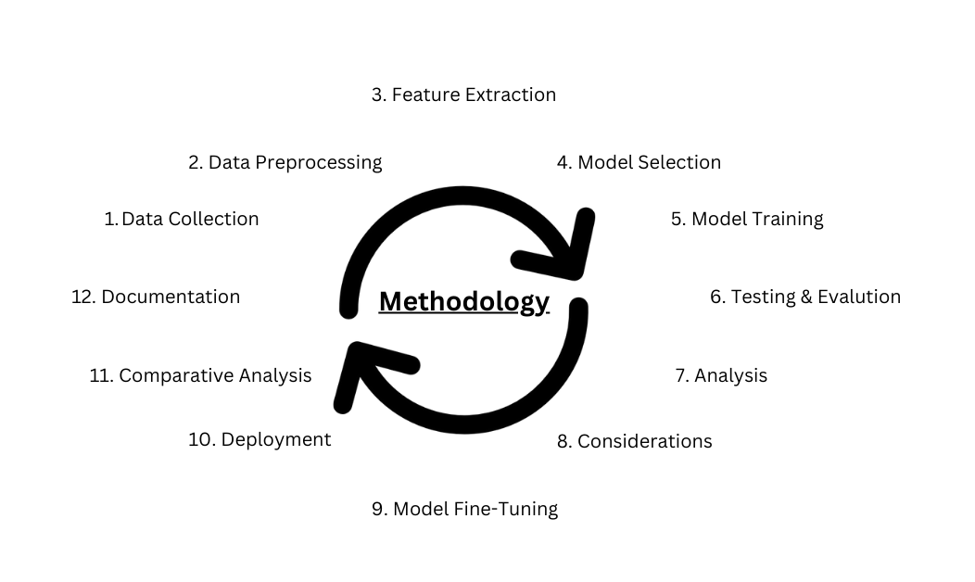
Methodology used

Slide 7
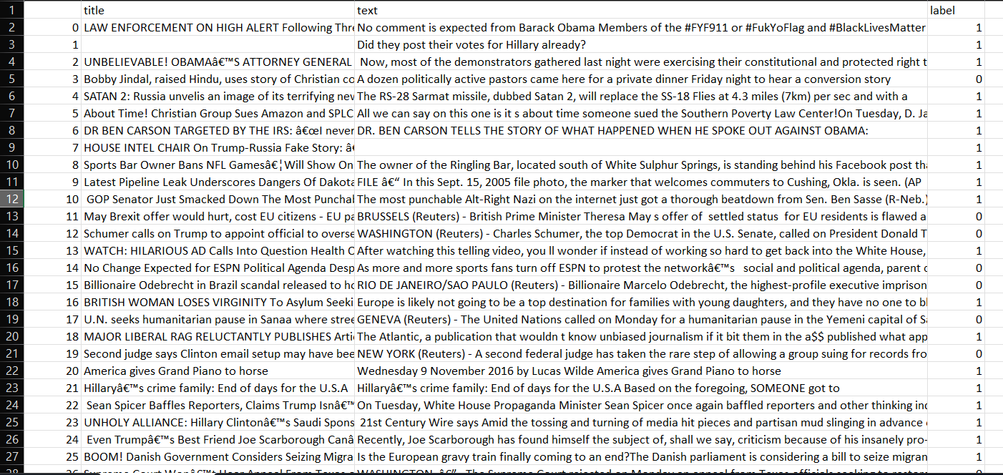
Results and Outputs
Step1:
Data Collection
We will need to collect the data either from dataset available on Kaggle, google or web scrap the data. And save it in excel file or in format of csv.

Slide 8
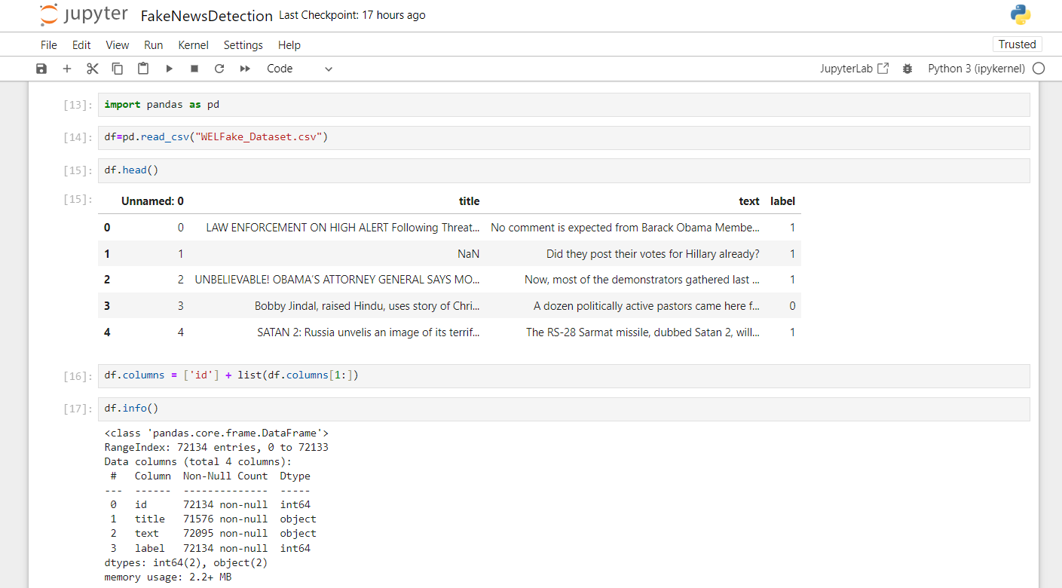
Results and Outputs
Step2:
Load the dataset for Data preprocessing in Jupyter notebook:

Slide 9
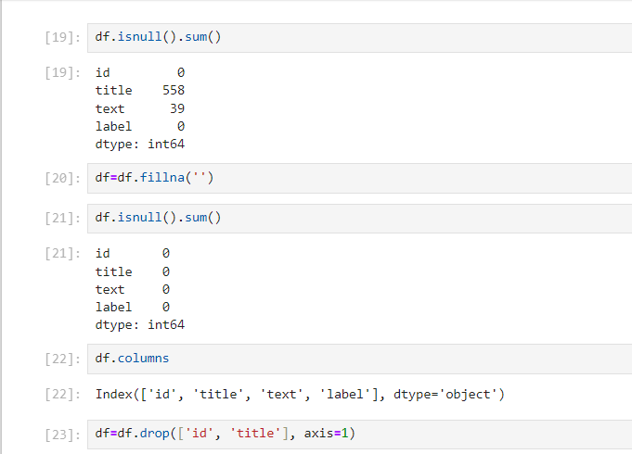
Results and Outputs
Step3:
Look for null values and fill them with ‘ ‘ or with some special letter. Also use the columns that are required for your analysis and drop the rest. Feature Selection is done.

Slide 10
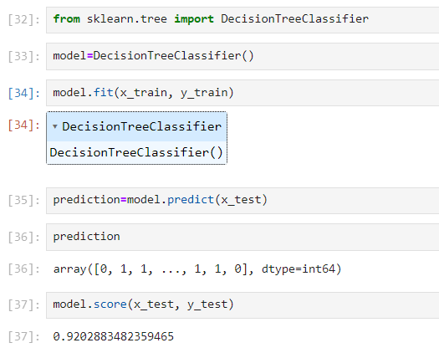
Results and Outputs
Step4:
Select the model that you wish to use. Here we used the DecisionTreeClassifier. Model selection is very important step.

Slide 11
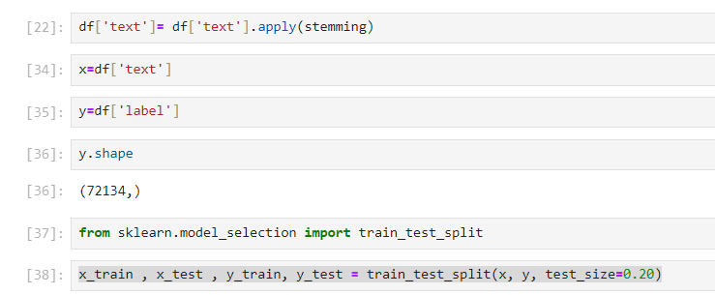
Results and Outputs
Step5:
Train the model and spilt the data into training and testing data

Slide 12
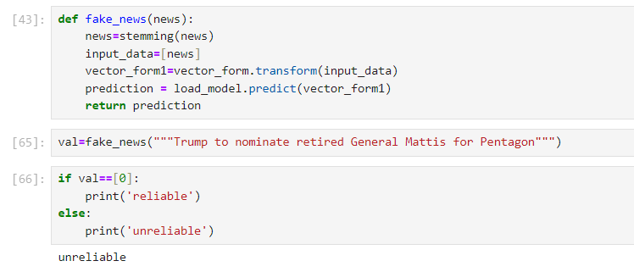
Results and Outputs
Step6:
Now we make a function for predicting whether the news is fake or real.
And we do Testing. If the news is reliable, it will show the user that it is reliable, otherwise unreliable.

Slide 13
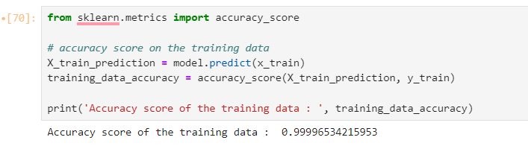
Results and Outputs
Step7:
Now once we know whether a news is fake or not. We will do analysis of the result and we will find the accuracy score of the training data.

Slide 14
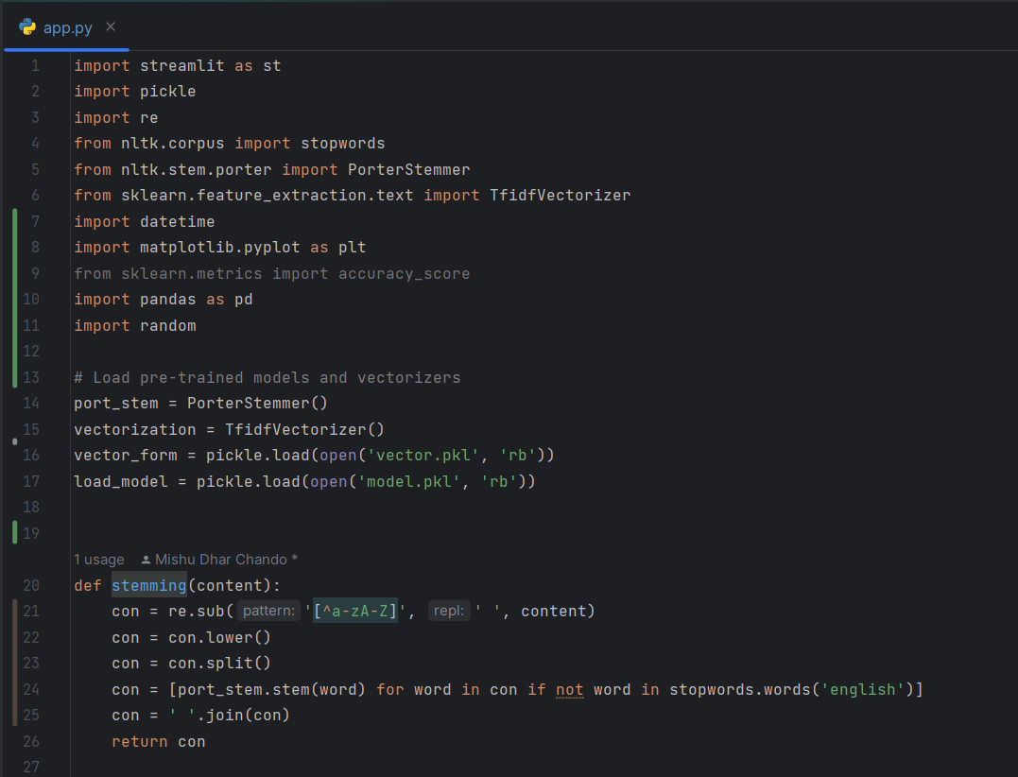
Results and Outputs
Step8:
Now since analysis is done, we can go for making the website. Use PyCharm or any IDE for python and import the libraries and write the code using streamlit.

Slide 15
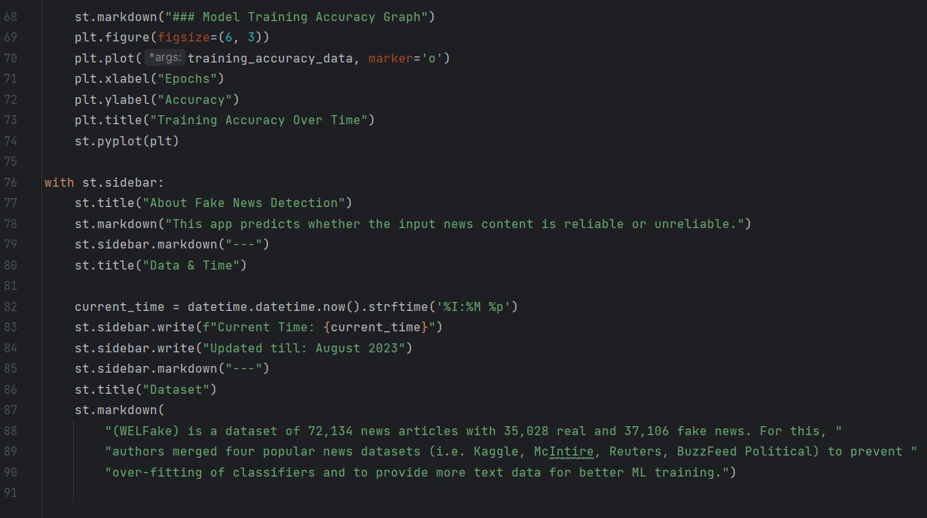
Results and Outputs
Step8:
Now since analysis is done, we can go for making the website. Use PyCharm or any IDE for python and import the libraries and write the code using streamlit.

Slide 16
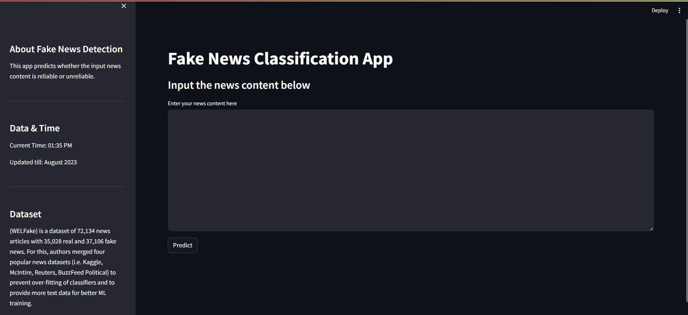
Results and Outputs
Step9:
Run the app.py using “Streamlit run app.py”
And the interface will look like this.

Slide 17
Results and Outputs
Step9:
It will show a lil description about the project and the current time. Along with it, it will also show until when the data is updated. Also about the dataset.

Slide 18
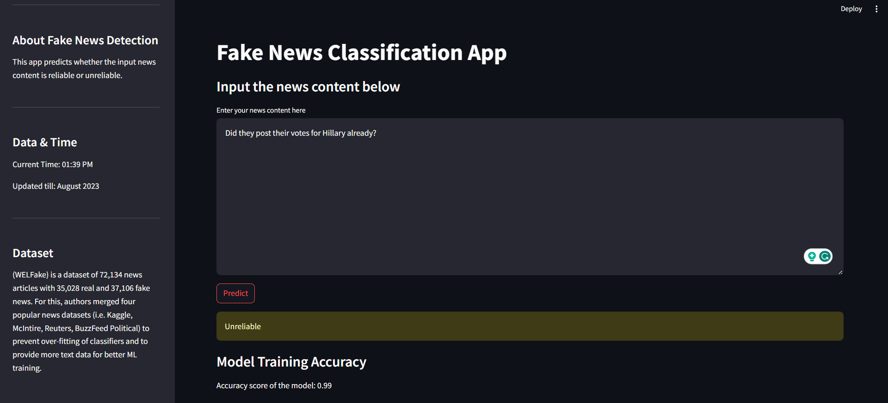
Results and Outputs
Step9:
Now I checked for the fake news and it says ‘unreliable’ which is correct. It also shows us the accuracy of the model which is 0.99

Slide 19
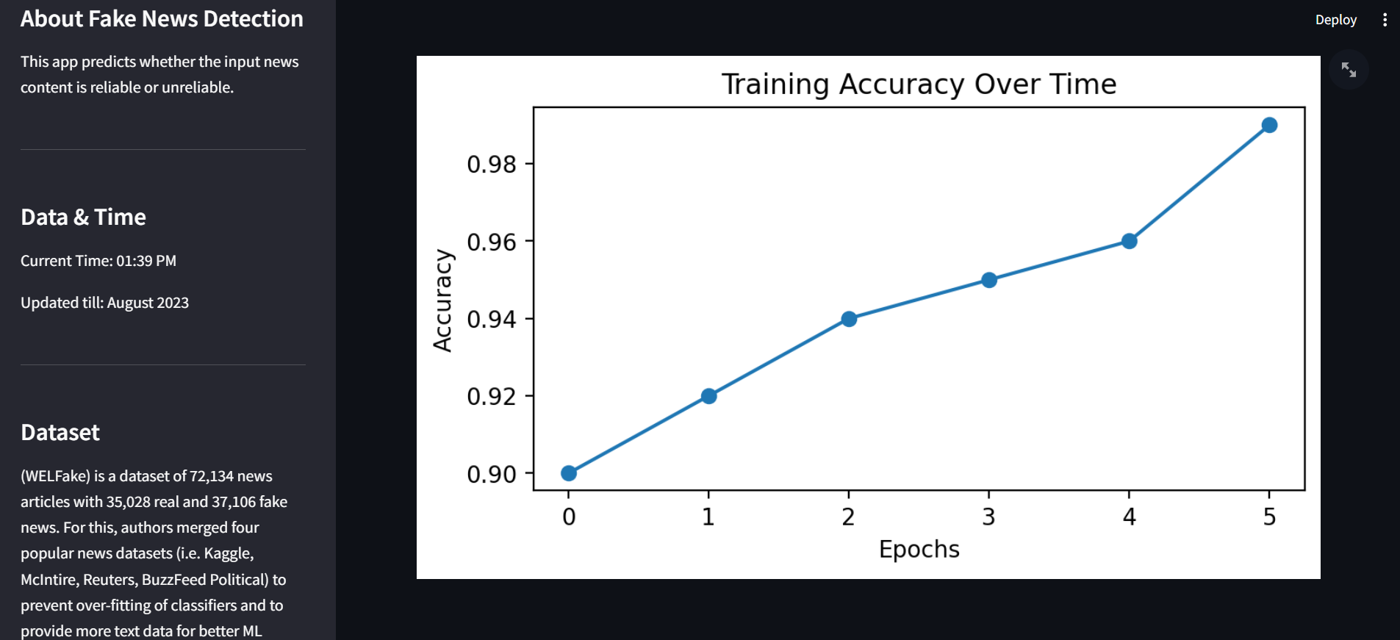
Results and Outputs
Step9:
And it will form a graph of the accuracy score

Slide 20
Conclusion
Our project aimed to tackle the problem of fake news by building a smart system that can tell if news is real or fake. We used fancy computer techniques to teach the system how to recognize clues that show whether a news story is true or not. After a lot of training and testing, the system got pretty good at it. This system can help people know which news to believe and stop false information from spreading. While the problem of fake news is complex, our project is a step towards making sure we can trust the news we read and share. We'll keep working to make it even better and to help everyone be smarter news consumers.

Slide 21
Future Scope
In the future, a web-based GUI can be created for the proposed fake news detection system to classify the news as fake or real on real-time social media platforms such as Facebook, Instagram, Twitter, WhatsApp, etc. Also, the annotated dataset in the sequence of images (with textual content written on them) will be collected and maintained from Facebook and Reddit platforms. The annotated dataset is often used for detecting fake images within the future as no such dataset is out there at the present.
The proposed system has the potential to provide an impulse to various emerging applications such as controlling the spread of fake news during elections, terrorism, natural calamities, crimes for the betterment of society. In the future, the efficiency and accuracy of the prototype can be enhanced to a certain level, and also enhance the user interface of the proposed model.

Slide 22
References
[1] Aral, S., Roy, D., and Vosoughi, S. (2018). internet dissemination of both factual and fake news. 359(6380), 1146–1151 in science.
[2] Wang, S., Lee, D., Shu, K., Mahudeswaran, D., & Liu, H. (2017). Social media fake news identification from a data mining standpoint. Newsletter for ACM SIGKDD Explorations, 19(1), 22–36.
[3] Friggeri, Adamic, Eckles, & Kleinberg, J. M. (2014). Friggeri, A., Adamic, L. A. A rumour spreads. Eighth International Conference on Weblogs and Social Media Proceedings, 101–110.
[4] Mihalcea, R., Lefevre, A., Kleinberg, B., & Pérez-Rosas, V. (2018). Fake news identification done automatically. 27th International Conference on Computational Linguistics: Proceedings, 3391-3401.
[5] Lui, M. T., Zhao, L., and Wang, W. Y. (2020). transformer combined with multi-modal fusion for the identification of bogus news. preprint arXiv:2006.11138, arXiv.

Slide 23
References
[6] Potthast, M., Stede, M., Schubotz, M., Kiesel, J., Reinartz, K., Bevendorff, J., & Gurevych, I. (2018). A Stylometric Investigation into Fake News and Hyperpartisanship. preprint arXiv:1801.07741; arXiv
[7] Liu, Y., Ruchansky, N., and Seo, S. (2017). "Csi: Cyberbullying": Tracking down instances of cyberbullying on the social media platform Instagram. The 2017 ACM Conference on Web Science: Proceedings, 13–22.
[8] Roy, D., Vosoughi, S., and Aral, S. (2018). spread of news, both accurate and fraudulent, online. Science, 359(6380), 1146–1151.

Slide 24
Thank You ☺

